Slide 1
Machine Learning Process in Diabetes Prediction
Kinfeurael Wubishet

Slide 2
Background
Diabetes is a chronic disease with significant health complications, including cardiovascular disease, kidney failure, and vision loss. Early detection is critical for timely intervention and management.
Traditional diagnostic methods rely on invasive and time-consuming tests, such as blood glucose measurements and HbA1c levels.
Machine learning (ML) offers the potential to analyse non-invasive and routine data to predict diabetes risk effectively and efficiently.

Slide 3
Objective
To design and implement a predictive model that can accurately identify individuals at risk of diabetes using clinical and demographic data.

Slide 4
ML process
1. Data Loading
The dataset, named diabetes.csv, is loaded into a Pandas DataFrame.

Slide 5
2. Exploratory Data Analysis(EDA)
Data distribution
Detecting Numerical and Categorical Value
Determine data type, shape, count
Histograms and density plots reveal the distribution of individual features:
Insights:
Identify skewed distributions that may require transformation.
Detect outliers for potential removal or treatment.

Slide 6
…
Data visualization
Analysis for Categorical data
Analysis for Numerical data
Correlation Analysis

Slide 7
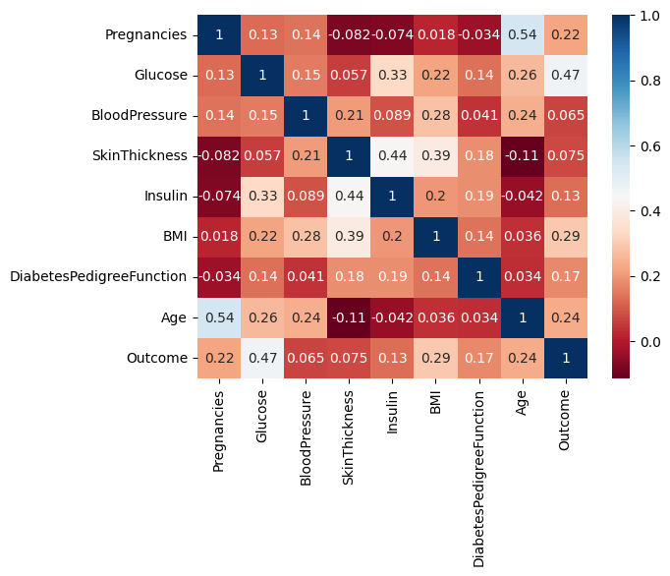
Correlation analysis
Heat map analyze relationships between features.

Slide 8
Correlation Analysis
Outcome correlations: Insulin and Blood Pressure show a strong positive correlation with the "Outcome" variable, suggesting these are important factors in predicting the outcome.
Other variables like Age also show moderate positive correlations.

Slide 9
3. Data Pre-processing
Data preprocessing is a critical step in ensuring the quality and consistency of data before it is fed into machine learning algorithms.

Slide 10
Detecting and Handling missing data
Missing data is identified using Pandas:
Techniques for handling missing values include:
Imputation: Filling missing values using statistical measures such as mean, median, or mode. KNN imputation is implemented.
Dropping rows/columns: Removing rows or columns with a significant proportion of missing values if they are not critical.

Slide 11
Outlier detection
Checking outlier using boxplot and replace it with threshold.
Feature Engineering
Categorical variables are transformed into numerical formats to be processed by machine learning models.
Techniques used:
One-hot encoding: Converts categories into binary columns.
Label encoding: Assigns numerical labels to categories.

Slide 12
4. Model selection
Various algorithms are explored for prediction:
Logistic Regression: Suitable for binary classification tasks.
Random Forest Classifier: Robust to overfitting and handles non-linear relationships well.
Support Vector Machine (SVM): Effective for small-to-medium-sized datasets.

Slide 13
Data Splitting
The dataset is divided into training and testing subsets.
Training set (80%) is used to train the model, while the testing set (20%) evaluates its performance.

Slide 14
Train the model
Train the model with logistic regression
Easy to implement and interpret with less computational cost

Slide 15
Model Evaluation
Accuracy: Measures overall correctness.
Precision and Recall:
Precision evaluates false positives.
Recall measures false negatives.
F1-score: Balances precision and recall.
Confusion Matrix
Analyzes prediction errors:
Provides a detailed breakdown of true positives, true negatives, false positives, and false negatives.

Slide 16
Test, Evaluation Hyperparametric tuning
Test the model using the test data set and optimize model parameters
. Results and Interpretation
Model Performance
The best-performing model achieves high accuracy and balanced precision-recall scores, indicating reliable predictions.
Feature Importance
Feature importance analysis identifies key predictors:
Features like glucose levels and BMI are significant predictors of diabetes.

Slide 17
Conclusion
A robust machine-learning pipeline was developed for diabetes prediction.
Key predictors were identified, and the model performed well on evaluation metrics.
Next Steps
Collect more diverse data to improve prediction.
Explore advanced for improved accuracy.

Slide 18
Thank You

